Slide 1




TailTales Progress presentation 3
Group Members:
Haroon Ahmed Bajwa
Aryan Tuwar
Vivian Zhonghui Liu
Mrinaal Nagpal
Report Date: April 9, 2025
Professor: Abedin Akkok

Slide 2


Overview
✅ The project has entered its final development phase
🔐 Secure authentication features successfully implemented
🛠️ Focus now on completing key user-facing functionalities
✨ UI enhancements made to the Contact section
🛒 Ongoing refinement of Appointment & Shopping experiences
🧱 Core infrastructure is stable and reliable
📅 On track to deliver remaining features as scheduled

Slide 3


Key Milestones
✅ 8 of 14 components completed
Represents ~70% of total project scope
🧱 Core infrastructure completed early
Includes Navbar, Footer, HeroSection, OurStory, and ShopInfo
🛍️ Key features implemented
TrendingProducts (April 3, 2025)
Authentication (April 7, 2025)
Contact section (April 8, 2025)

Slide 4

Key Milestones
🚧 Active development on remaining user-facing components
AppointmentSection – ⏳ In Progress
CartPage – ⏳ In Progress
ProfilePage – ⏳ In Progress
SignupSection – ⏳ In Progress
CheckAppointment – ⏳ In Progress
📈 Team remains on track to meet upcoming goals

Slide 5


Recent Progress
🔐 Authentication Completed
Secure login/logout via Firebase integration
Stable session handling fully implemented
🎨 UI Enhancements Delivered
Contact section polished for UX clarity
Major updates to TrendingProducts, BlogSection, and AppointmentSection components
🔗 Component Integration Strengthened
Smooth communication across interdependent modules
Authentication flow seamlessly linked to Profile Management
🧱 Well-Structured Development Environment
Clear separation of concerns (components, styles, services)
Codebase supports maintainability and effective team collaboration

Slide 6
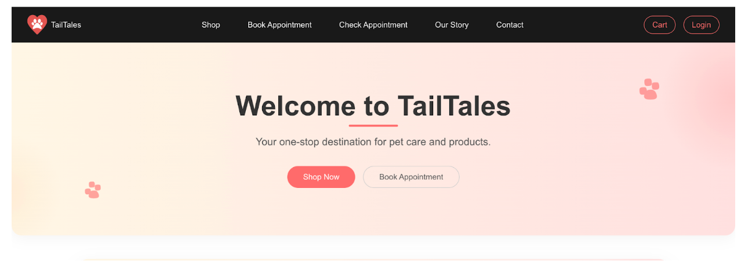
Main page

Slide 7
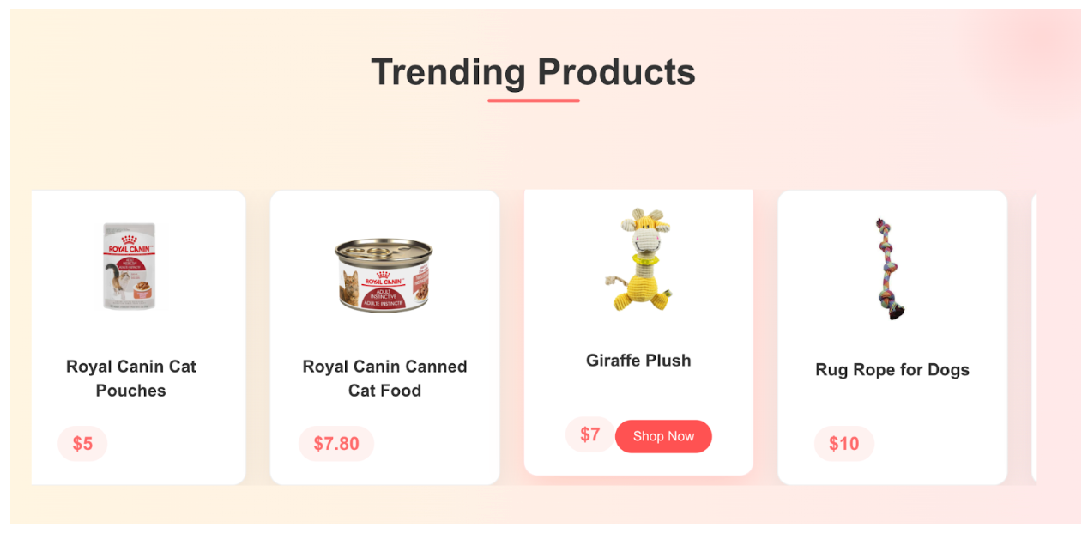
The trending products at the main page:

Slide 8
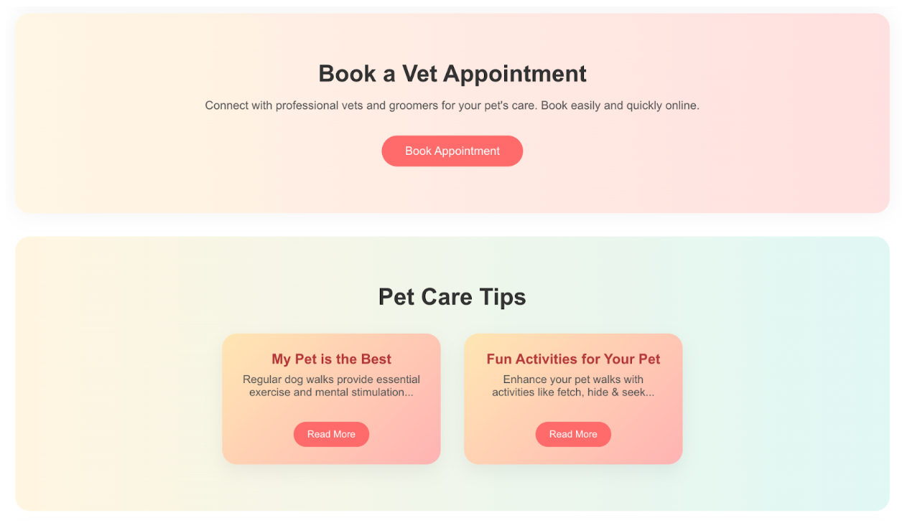
The booking appointment section and the blog tips section at the main page:

Slide 9
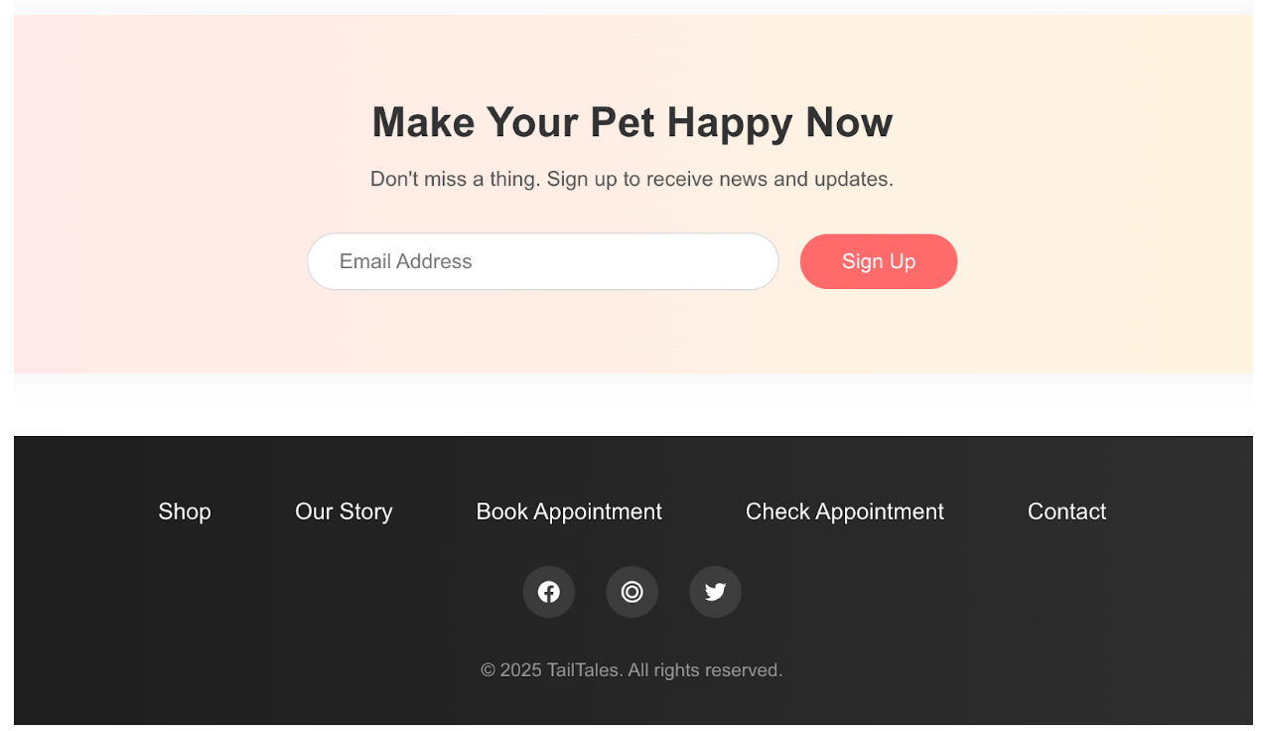
The signup section and footnotes at the main page:

Slide 10
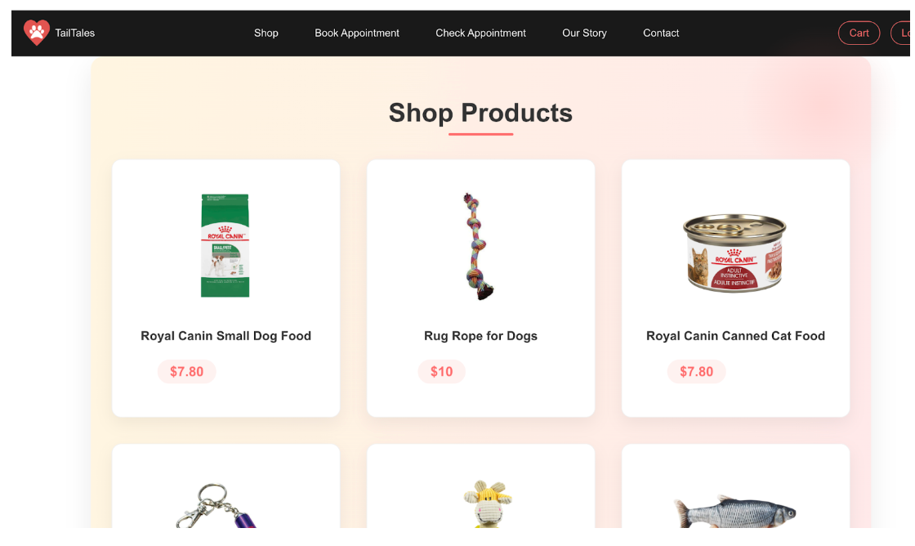
Shop products display:

Slide 11
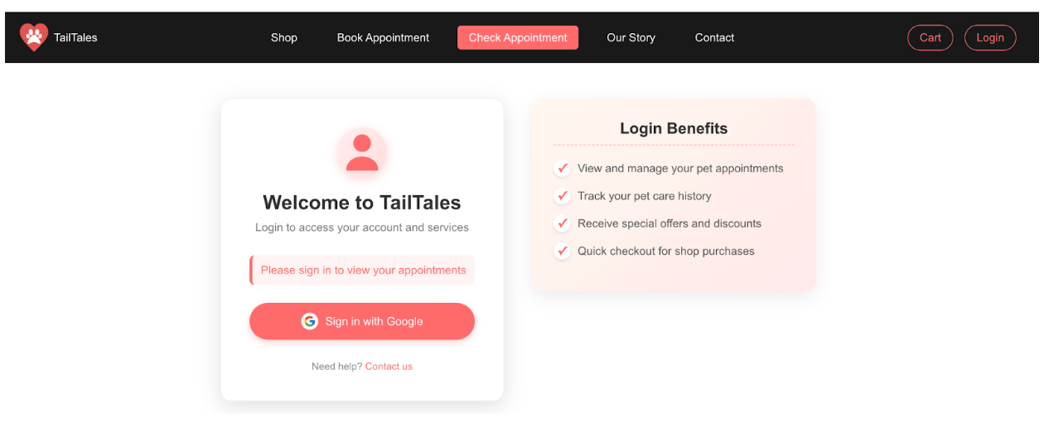
Check appointment section before login:

Slide 12
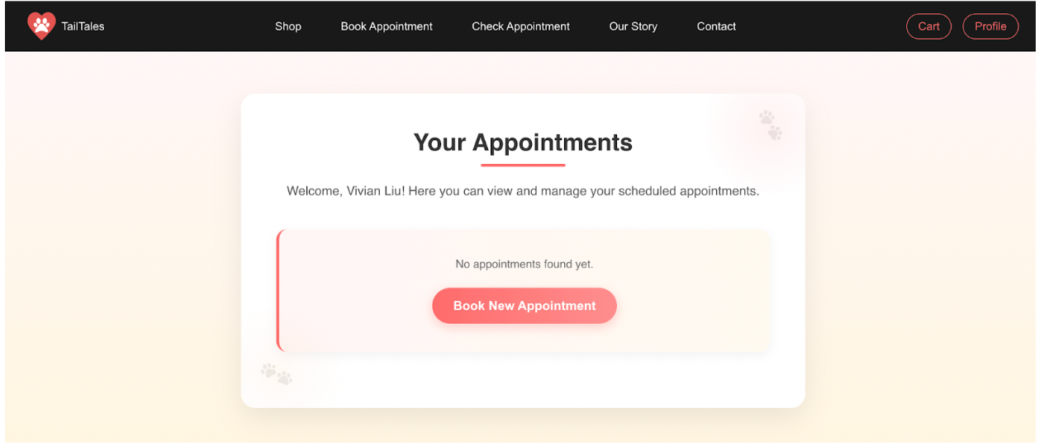
User after login (Example, there is no appointment yet):

Slide 13
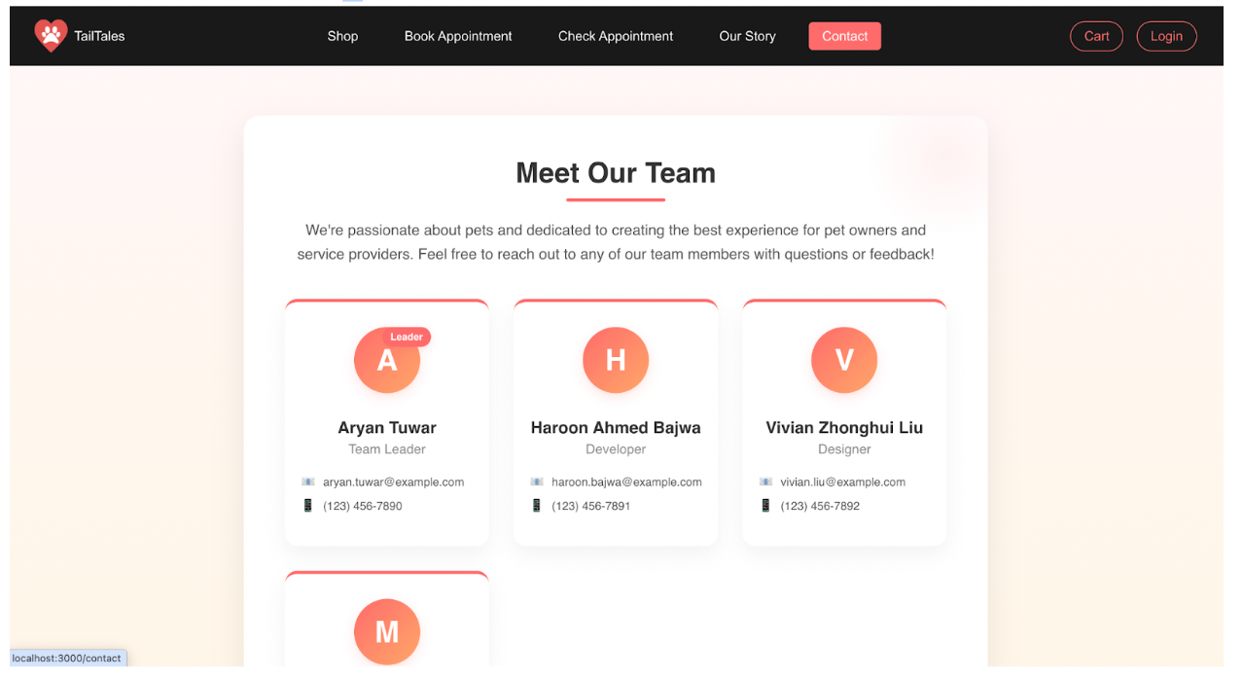
Contact us section:

Slide 14
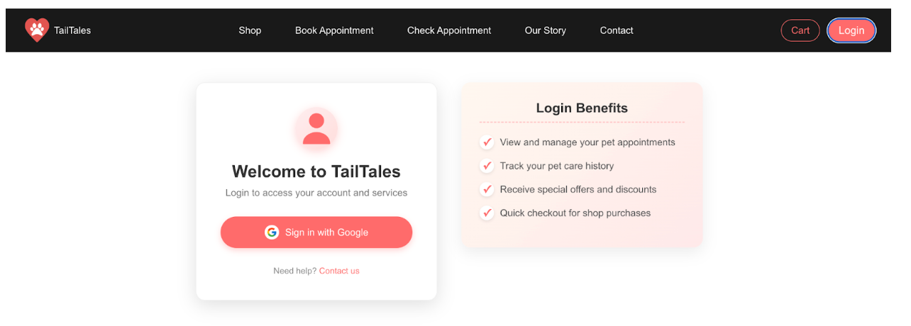
Login section:

Slide 15
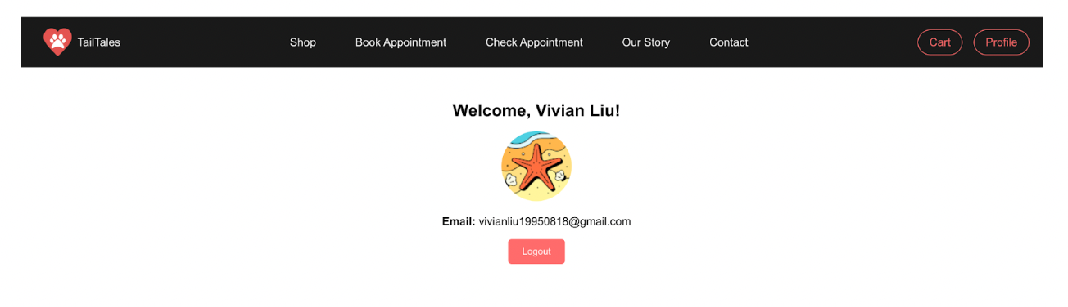
Sign in Google (Example):

Slide 16
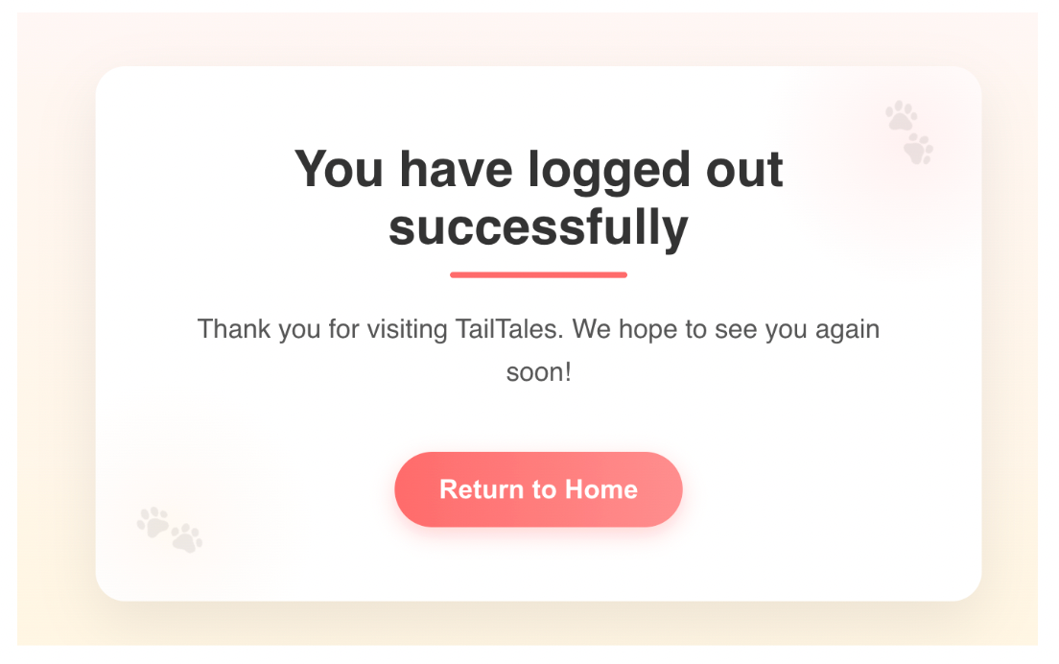
Click logout and display information:

Slide 17
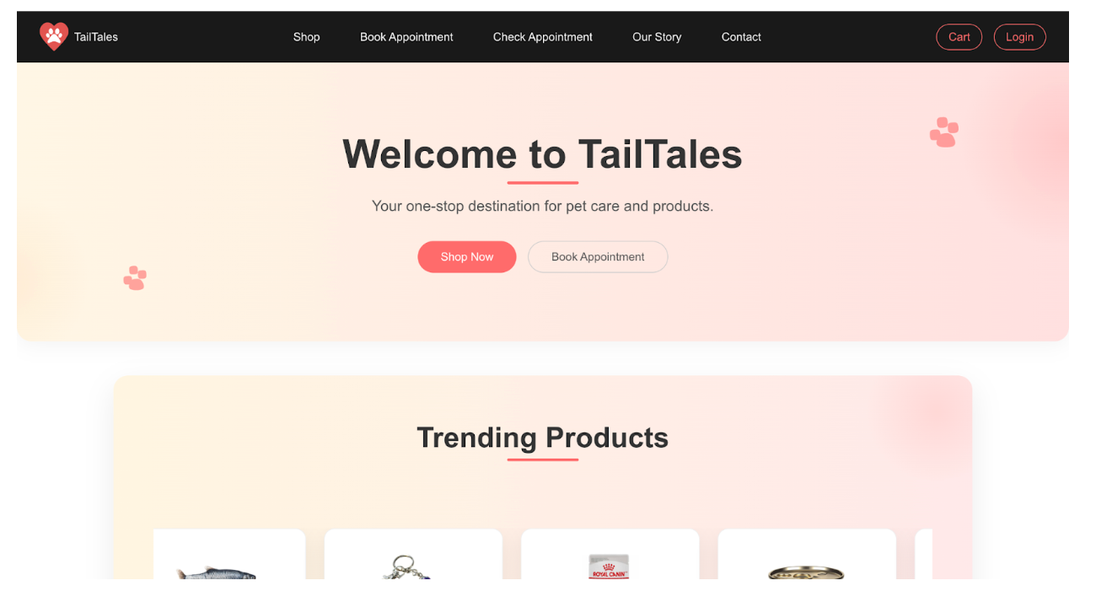
Click the “Return to Home” and back to the main page:

Slide 18


Planned Work to Finish
✅ Finalize Core Functionalities
Appointment booking, validation, and schedule viewing
Cart fixes, secure checkout, and order tracking
Profile pages and signup validation
🚀 System Optimization
Reduce API latency & improve load times
Implement caching for key data
🧪 Quality Assurance
Test authentication flows and responsiveness
Ensure cross-browser compatibility
📚 Documentation Updates
Update component docs
Create user guides for appointment & shopping features

Slide 19

High-Priority Issues
🛒 Cart Functionality
Fix quantity update bugs to ensure a smooth checkout flow
📅 Appointment Booking
Complete time slot and conflict handling for core usability
🐢 API Performance
Optimize backend to reduce latency in data-heavy tasks
🌐 Cross-Browser Compatibility
Resolve profile page issues on affected browsers
📋 Project Management
Improve task tracking and status updates in Jira

Slide 20

Issue Logs
Issue | Description | Status | Assigned To
Navbar responsiveness | Breaks on smaller screens | Resolved | Aryan Tuwar
Cart functionality | Quantity update issues | In Progress | Aryan Tuwar
Slow API response | Lag in backend endpoints | Pending | Vivian Liu
Profile page loading | Compatibility issues on some browsers | Testing | Mrinaal Nagpal
Appointment validation | Booking conflicts not properly handled | New | Mrinaal Nagpal
Firebase auth flow | Occasional token refresh issues | New | Aryan Tuwar

Slide 21



Next step & Conclusion
✅ Next Steps
Finalize cart functionality and fix quantity updates
Complete appointment booking & management system
Address API performance and browser compatibility
Conduct comprehensive testing across all modules
Prepare for user acceptance testing with stakeholders
📌 Conclusion
~70% of features completed — on schedule
Authentication implementation successfully delivered
Focus now on cart, appointments, and performance
The project remains on track for timely completion
Emphasis on integration, optimization, and testing for high-quality delivery

